Slide 1
Postpartum family planning
Training course in family planning 2022
Rita Kabra, MBBS, MPH
Contraception and Fertility Care Unit
Department of Sexual and Reproductive Health

Slide 2
Training objectives
On completion of the course students should be able to:
  Describe the importance of PPFP & integration across contact points.
  Apply WHO guidance on using contraceptive during the post partum period.
  Define the basic indicators used for monitoring PPFP and apply them in their countries.

Slide 3
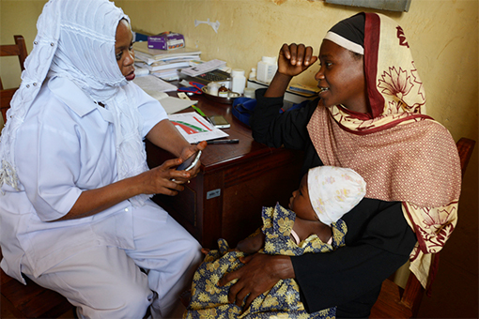
Postpartum family planning
Postpartum family planning (PPFP)
refers to the prevention of unintended and closely spaced pregnancies through the first 12 months following childbirth to women and their partners.
Postabortion family planning refers to the prevention of unintended and closely spaced pregnancies following an abortion.
Post pregnancy family
planning = postpartum family planning as well as post abortion family planning.
Source: WHO (New WHO tool helps guide contraception choice following childbirth)

Slide 4
Unmet need
The percentage of fecund women of reproductive age who want no more children or to postpone having the next child, but are not using a contraceptive method.
Women who are pregnant or less than six months postpartum who did not intend to become pregnant at the time they conceived and were not using a contraceptive method are assumed to have an unmet need for modern contraception.

Slide 5
Postpartum family planning
The postpartum period is one of the most vulnerable times in a women’s life and the need for family planning is highest during this time. However, it is also the period when the need is least likely to be met.
Worldwide, more than 9 out of 10 women want to avoid pregnancy for 2 years after having had a baby, but 1 in 7 of them are not using contraception.
PPFP is often ignored, and a number of biases and misconceptions have limited its availability.
Notes:
Programming strategies for postpartum family planning. 2013. Retrieved on 16th July 2020 from https://apps.who.int/iris/bitstream/handle/10665/93680/9789241506496_eng.pdf
FP 2020. Postpartum/post-abortion family planning. Accelerating the global movement. Retrieved on 13th November 2020 from http://www.familyplanning2020.org/ppfp#_ftn2

Slide 6
Why postpartum family planning is important?
PPFP can save mothers’ lives – family planning can prevent more than one-third of maternal deaths.
PPFP can also save babies’ lives – family planning can prevent 1 in 10 deaths among babies if couples space their pregnancies more than 2 years apart.
Short birth intervals increase risks of adverse maternal and infant outcomes, such as low-birth weight & infant mortality.
Birth intervals shorter than 18 months have the highest mortality risk for infants and children under-five, with decreasing risk as birth intervals increase up to 36 months.
As a result, the World Health Organization (WHO) recommends birth intervals of 2–3 years.

Slide 7
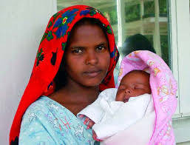
Timing of postpartum family planning guidance
Traditionally given at a 6-week postpartum visit.
However, guidance in the immediate postpartum is recommended and appropriate (within 10 minutes or up to 48 hours after birth*).
Extended PPFP - from 48 hours up to one year after birth**.
*Asnake M. et al. Leveraging maternity waiting homes to increase the uptake of immediate PPFP in primary health care facilities in Ethiopia. Ethiopian journal of health development. 2021; 35(1).
**USAID. Family planning needs during the extended postpartum period in Uttar Pradesh, India. 2008. Retrieved from https://pdf.usaid.gov/pdf_docs/PNADM908.pdf

Slide 8
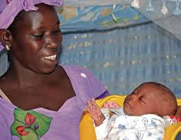
Complexity of postpartum family planning decision-making
Changing needs throughout the first year postpartum, includes:
Changes in breastfeeding status
Uterine involution
  Affects eligibility for barrier methods, tubal sterilization
Venous thromboembolism risk
IUD expulsion risk

Slide 9
When should contraception be provided?
Pregnancy can occur by 6 weeks if a woman does not exclusively breastfeed, so it is important to make sure that a method is provided by 4 weeks postpartum
Women who do breastfeed have postpartum amenorrhoea for varying lengths of time, depending on their breastfeeding practices, but ovulation and therefore pregnancy can occur before menstruation resumes.
For women who are using the lactational amenorrhoea method (LAM) as their contraceptive method, it is important to support them to choose and start another method of family planning by 6 months postpartum.
Aim:
To ensure that women have a method of contraception that they can start before the risk of pregnancy returns after childbirth.
The chosen method of contraception to be started before the woman leaves the birthing facility.

Slide 10
Integration of postpartum
family planning

Slide 11
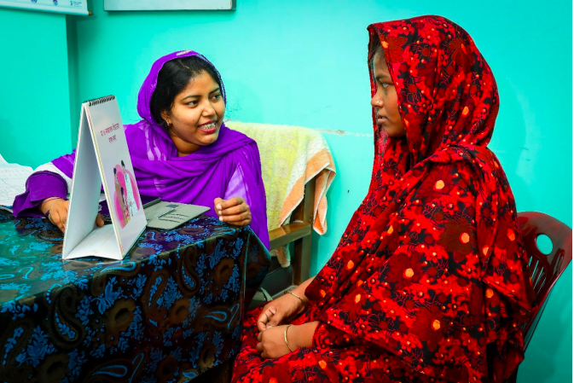
Integration of PPFP across contact points
Antenatal
Child birth
Post partum care
Immunization & Child birth
Source: USAID-Expanding PPFP services in Bangladesh

Slide 12
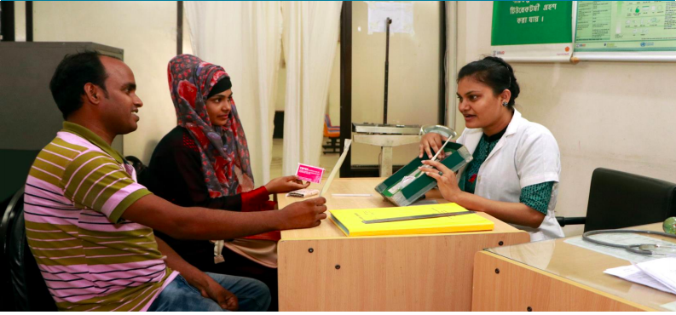
Measures to avoid missed opportunities for PPFP (1)
Antenatal period
Healthcare providers who provide antenatal care should be given the time and opportunities to be trained to give contraceptive advice.
Add “Contraceptive counselling” to maternity checklists.
Provide women & partner information (in a variety of forms) about the importance of PPFP and the range of methods available.
Document the method of contraception chosen e.g. in the Maternity Case Record. Videos or brief talks about PPFP in clinic waiting rooms & Posters emphasizing the importance and advantages of PPFP should be available and visible.
Woman’s choice should be communicated to the local community-based distribution (CBD) network, if available, so that a CBD worker can provide follow-up care as needed.
Source: USAID-Expanding PPFP services in Bangladesh

Slide 13
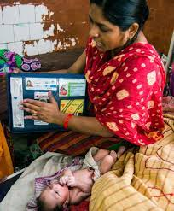
Measures to avoid missed opportunities for PPFP (2)
In the labour ward
Ensure that healthcare professionals (HCPs) who provide intrapartum care are trained to give contraceptive advice & provide all methods, including IUD & implant insertion.
Ensure that contraceptive implants and IUDs & the necessary equipment for their insertion are always available.
Source: Family planning 2020 (Immediate PPFP)

Slide 14

Measures to avoid missed opportunities for PPFP (3)
Postnatal ward
When women come into the delivery suite too late in labour to discuss contraception, HCPs on the postnatal ward should be competent to discuss all methods of contraception and to insert implants and IUDs.
All methods of contraception should be available in the postnatal ward, including contraceptive implants and IUDs, and the necessary equipment for insertion (including long forceps and a supply of IUDs).
Immunization and postnatal clinics
Ensure that HCPs at baby immunization clinics are trained to give contraceptive advice and to provide all methods, including implants. and IUDs, or are able to refer appropriately.
In all settings:
Ensure the involvement of all appropriate partners including CBD workers, midwives and peer educators.
Source: USAID-Expanding PPFP services in Bangladesh

Slide 15
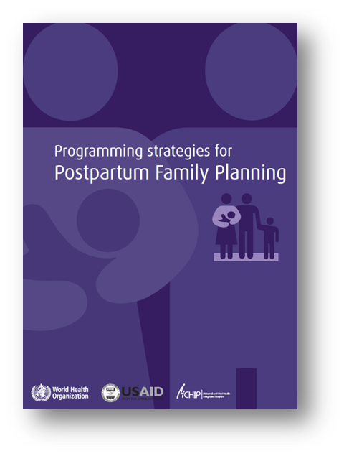
Role of health service managers
It is not enough for doctors, nurses and other healthcare workers to be well trained to provide postpartum contraception safely and appropriately.
Service managers and other staff responsible for health facilities, including procurement, need to play their part in ensuring that all opportunities for providing PPFP are used.
Guidance For programme managers & planners to integrate PPFP into national & subnational strategies

Slide 16
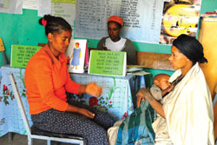
Counselling for postpartum family planning
Discuss the importance of birth spacing
Explain the rapid return to fertility for women who are not breastfeeding
Discuss return to sexual activity
Explain benefits of LAM and exclusive breastfeeding
Discuss family planning options and when each method can be started
Counselling can be integrated within maternal, newborn and child health services

Slide 17
Integration of PPFP across contact points
Integrating FP and immunization services in the extended postpartum period is a promising high impact practice (HIP) https://www.fphighimpactpractices.org/briefs/family-planning-and-immunization-integration/
Offering contraceptive counseling & services as a part of care provided during childbirth at health facilities (immediate PPFP) is a proven high impact practice in FP https://www.fphighimpactpractices.org/briefs/immediate-postpartum-family-planning/

Slide 18
WHO guidance on
postpartum family planning

Slide 19
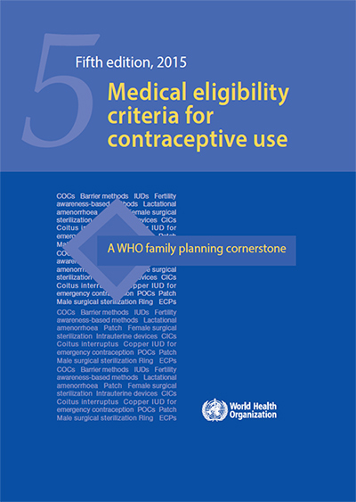
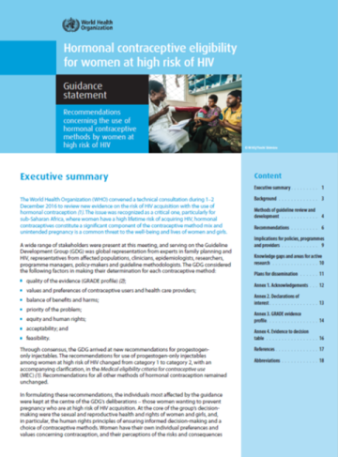
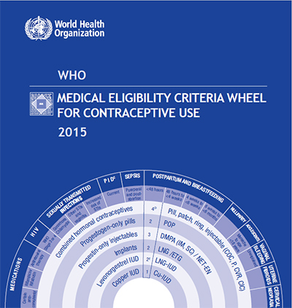
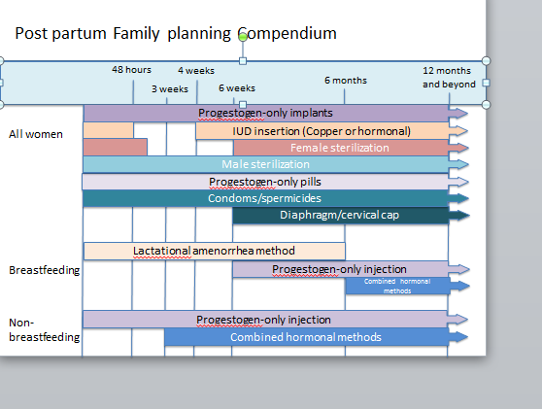


WHO guidance on postpartum family planning
Mobile app android IOS
Notes:
Highlight the many sources of guidance – each has a different angle and scope for recommendations on PPFP

Slide 20
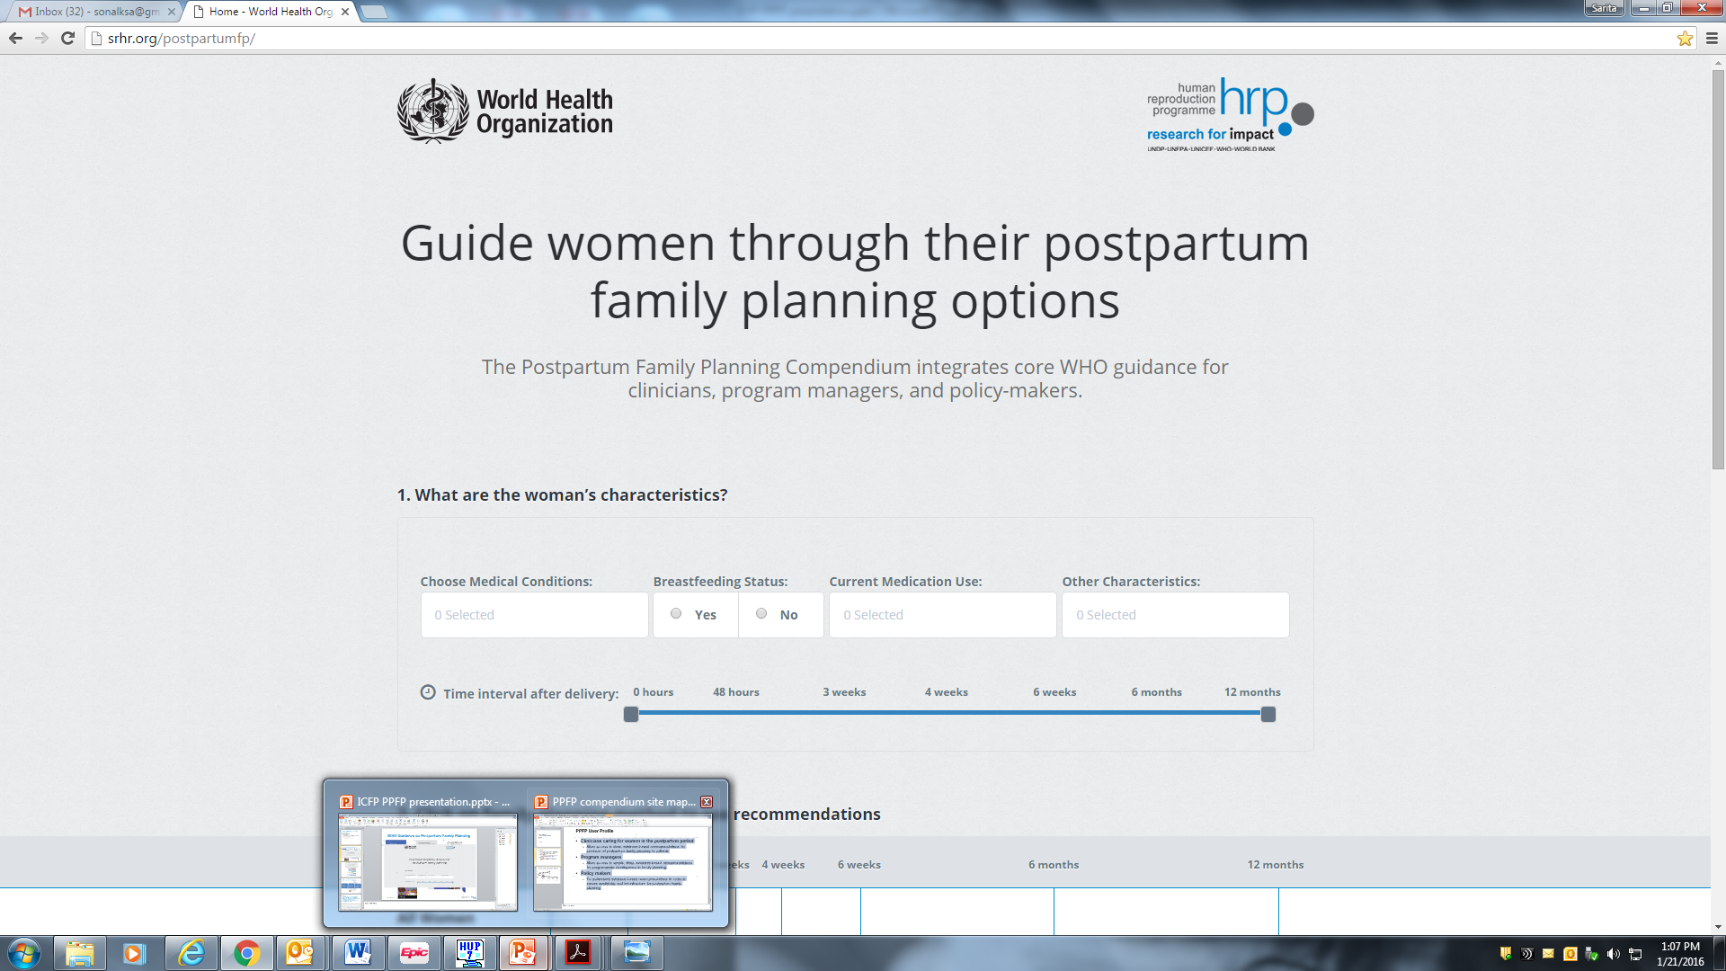
Postpartum family planning guidance at your fingertips: Place a bookmark!
https://postpartumfp.srhr.org/

Slide 21
Contraceptive options /method eligibility:
The first year postpartum
48 hours
4 weeks
12 months and beyond
3 weeks
6 months
6 weeks
Progestogen-only implants
All women
IUD insertion (Copper or hormonal)
Female sterilization
Male sterilization
Progestogen-only pills
Condoms/spermicides
Diaphragm/cervical cap
Lactational amenorrhea method
Breastfeeding
Progestogen-only injection
Combined hormonal methods
Non-breastfeeding
Progestogen-only injection
Combined hormonal methods
Notes:
Non-breastfeeding women:
0-21 days:
COC is category 3,
POC is category 1
>=21 days-42 days:
COCs are category 2
POCs are category 1
<48 hours
Cu-IUD and LNG-IUD are category 1
48h-4 weeks: IUDs are category 3

Slide 22
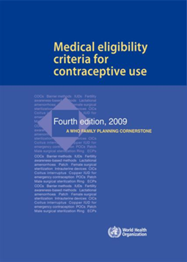
Breastfeeding and postpartum
Time period | Progestogen-only pill | DMPA/NET-EN injectable | Levonorgestrel/ Etonogestrel implants
< 6 weeks postpartum | 2 | 3 | 2
≥ 6 weeks postpartum | 1 | 1 | 1
MEC recommendations
Time period | LNG-IUD
<48 hours including insertion immediately after cesarean section | not breastfeeding = 1 breastfeeding = 2
≥ 48 hours to < 4 weeks | 3
≥ 4 weeks | 1
Women who breastfeed have more safe contraceptive options
Implants (LNG, ETG) and progestogen-only pills (POPs) can now be offered in the immediate postpartum period.
LNG-IUD can be immediately inserted in first 48 hours.
Notes:
WHO Consultation in 2008 reviewed the epidemiological data as well as the effect of progesterone on the neonatal brain, as there has been a theoretical concern about long term effects of progestogen exposure to the neonate. However, clinical studies were determined to be inadequate to answer this question.
The experts concluded that direct evidence suggests that hormonal contraceptive use among breastfeeding women prior to 6 weeks postpartum does not adversely affect infant health, growth, or development, but noted that significant limitations with the evidence.
Consequently, in the 4th edition of the MEC, WHO recommend that use of progestogen-only methods (other than the LNG-releasing IUD), are not generally recommended for breastfeeding women < 6 weeks postpartum, unless other methods are not available or unacceptable to the woman.
Beyond 6 weeks postpartum, breastfeeding women can use these methods without restriction.
For the LNG-IUD, this method is generally not recommended until 4 weeks postpartum for women who are breastfeeding, unless other methods are not available or unacceptable. Beyond 4 weeks postpartum, breastfeeding women can use the method without restriction.
Evidence is reassuring that progestogen-only contraceptives do not compromise a woman’s ability to breastfeed.
Evidence is reassuring that progestogen-only contraceptives do not adversely affect infant health, growth, or development in the first year postpartum.
Effects, or absence of effects, beyond the first year post-partum is not established.

Slide 23
Monitoring postpartum family planning

Slide 24
Monitoring postpartum family planning
Monitoring PPFP is an ongoing process that provides regular feedback on the progress being made towards achieving the goals and objectives.
It should be part of the routine National Health Management Information Systems (N-HMIS).
The lessons from the monitoring process should be reviewed periodically and used to inform actions and decisions.
Monitoring and evaluation of PPFP programmes is important to gain evidence about its effectiveness.

Slide 25
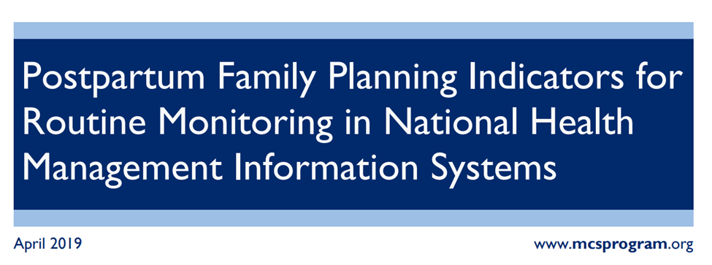
Indicators to monitor PPFP in the NHMIS
Percent of women who deliver in a facility and initiate or leave with a modern contraceptive method prior to discharge.
Percent of women who delivered in a facility and received counselling on FP prior to discharge.

Slide 26
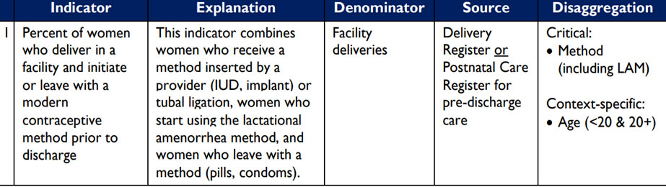
1. Indicator for PPFP uptake prior to discharge after a birth
The complete definition can be found in
https://www.data4impactproject.org/prh/family-planning/fp-mch/number-percent-of-women-who-delivered-in-a-facility-and-initiated-or-left-with-a-modern-contraceptive-method-prior-to-discharge/

Slide 27
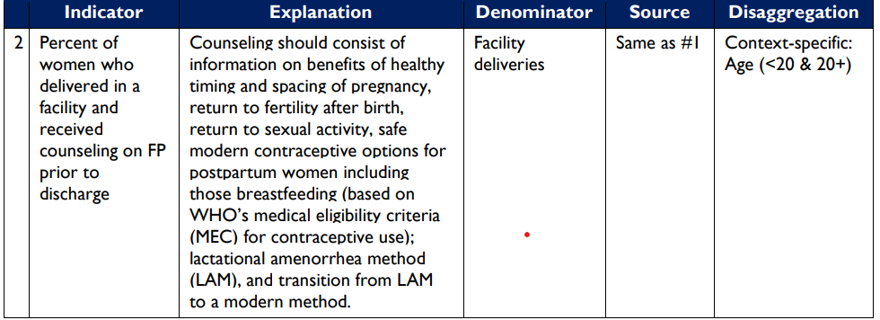
2. Indicator on FP counseling prior to discharge

Slide 28
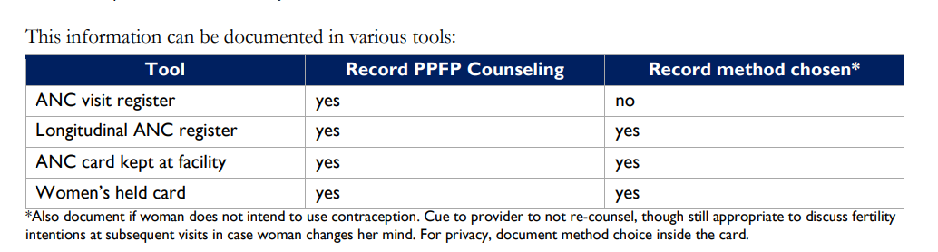
Document PPFP counseling during pregnancy and method choice

Slide 29
Further reading
Programming strategies for postpartum family planning. WHO; 2013. https://apps.who.int/iris/bitstream/handle/10665/93680/9789241506496_eng.pdf
Offering contraceptive counseling & services as a part of care provide during childbirth at health facilities (immediate PPFP) is a proven high impact practice in FP –
High Impact Practices in Family Planning (HIPs). Immediate postpartum family planning: A key component of childbirth care. Washington, DC: USAID; 2017 Nov.
https://www.fphighimpactpractices.org/briefs/immediate-postpartum-family-planning/
Integrating FP and immunization services in the extended postpartum period is a promising high impact practice (HIP) -
High-Impact Practices in Family Planning (HIP). Family Planning and Immunization Integration: Reaching postpartum women with family planning services. Washington, DC: USAID; 2013 Jul. https://www.fphighimpactpractices.org/briefs/family-planning-and-immunization-integration/
Postpartum indicators for routine monitoring –
Postpartum family planning indicators for routine monitoring in National Health Management Information Systems. MCSP; 2019 Apr. https://www.mcsprogram.org/resource/postpartum-family-planning-indicators-for-routine-monitoring-in-national-health-management-information-systems/

Slide 30
Readings and videos
Read the WHO factsheet on Family planning/contraception methods
https://www.who.int/news-room/fact-sheets/detail/family-planning-contraception
Watch the video on WHO and the development of contraceptive methods
https://www.youtube.com/watch?v=jHb69wklWN4
Watch video on Human Rights and Contraception https://www.youtube.com/watch?v=4ubJzsYeJTI&t=513s

