Slide 1
Family planning services during the COVID 19 pandemic
Training course in family planning 2022
Rita Kabra, MBBS, MPH
Contraception and Fertility Care Unit
Department of Sexual and Reproductive Health

Slide 2
Training objectives
By the end of this session, you should be able to:
  Describe the rationale for continuing FP services during the COVID-19 pandemic
  Describe the effect of COVID-19 on Family planning services
  Apply WHO guidance to maintain FP services during the COVID-19 pandemic

Slide 3
Main benefits of family planning/contraception
1. Secures the well being and autonomy of women
2. Empowers people and enhances education
3. Supports the health and development of communities
4. Prevents unplanned pregnancy, abortion and pregnancy-related health risks of women
5. Prevents adolescent pregnancy
6. Reduces infant mortality and prevents HIV/AIDS transmission to newborns
7. Slows population growth
Notes:
Delaying having children can give people the opportunity to complete education or further studies
Waiting to become pregnant at least 24 months after birth can lead to health benefits for the mother and baby.
Spacing births allows the mother to recover physically and emotionally before she gets pregnant again, and faces the demands of pregnancy, birth and breastfeeding.
Limiting the number of children in a family means more resources for each child and more time for the parents to dedicate to each child.
Family planning can also help couples in a sexual relationship not to be worried about the woman getting pregnant.
STIs including HIV/AIDS can also be prevented with correct and consistent use of condoms.
Younger women (adolescents) can delay pregnancy until their bodies are mature and they are ready in terms of their life course.
Older women (over 35) can prevent unwanted pregnancies that are often risky for their health and can lead to complications for both mothers and infants.

Slide 4
Meeting the unmet need for contraception
Meeting the unmet need for contraception across the reproductive cycle in low- and middle-income countries and offering all pregnant women and their newborns the standard care would result in :
  reductions of unintended pregnancies by 68%
  unsafe abortions by 72%
  maternal deaths by 62%
  neonatal deaths by 69%. *
  Recommended by the World Health Organization (WHO)
* Adding it up: investing in sexual and reproductive health. New York, NY: Guttmacher Institute, 2020.

Slide 5
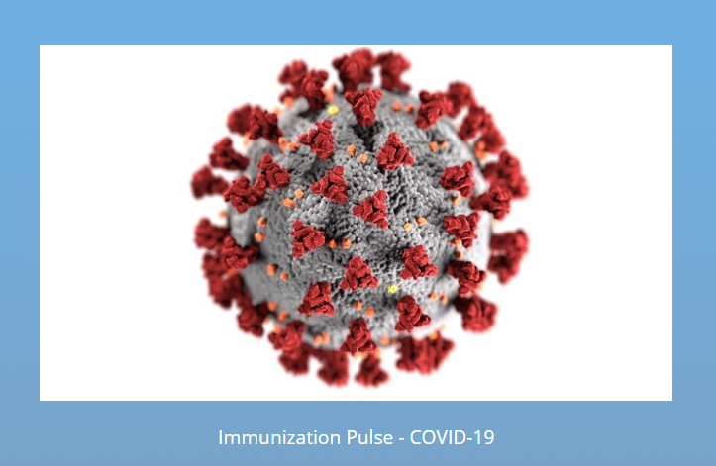

Rationale
  The COVID-19 pandemic is posing unprecedented challenges to governments and health systems.
  The direct impact of the pandemic is already significant; however, evidence suggests that the most important effects will be indirect.
  In multiple settings, access and utilization of essential health services have been compromised.
  According to surveys conducted by WHO, UNICEF, MOMENTUM 2A, and others in previous epidemics, such as SARS in Taiwan and Ebola in West Africa, impacts on service utilization resulted in higher number of deaths than the disease outbreak itself.
  Increase in unmet need.
  Unintended pregnancies and its consequences.

Slide 6
FP Services during COVID- 19 pandemic
Disruption or interruption in the provision of family planning services during the COVID-19 crisis may result in a dramatic increase in unintended pregnancies and need for abortion care.
The Guttmacher Institute estimates that a 10% proportional decline in short- and long-term reversible contraceptive use would result in an additional 49 million women with an unmet need for modern contraception and an additional 15 million unintended pregnancies, over the course of a year.
Maintaining essential services is crucial to protecting girls and women from the negative health consequences of unintended pregnancies, such as unsafe abortion and serious pregnancy complications, which contribute to maternal and infant mortality.
Notes:
This has implications for changes in the method mix, discontinuation rates for short-term contraceptive methods (STMs), and subsequent risks for unintended pregnancies and need for comprehensive abortion care (CAC). Further, as STM users have a lower median age than LARC users, the risk of unintended pregnancies and CAC will be higher among younger and poorer women who are already more vulnerable.

Slide 7
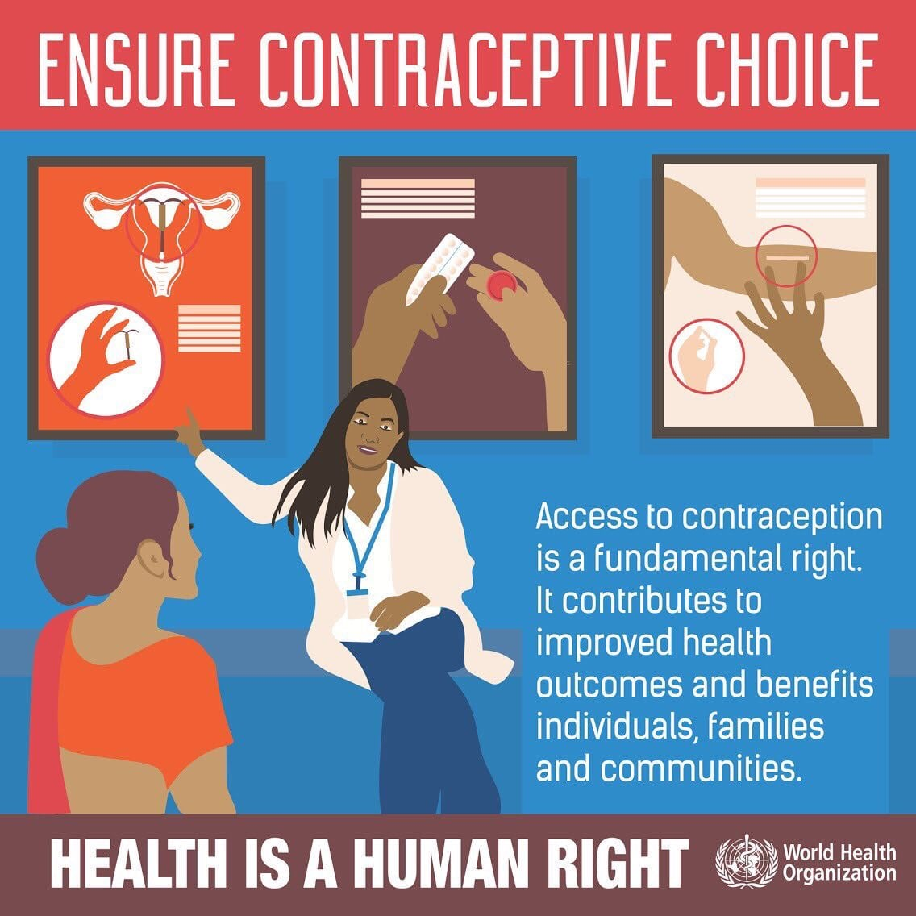
FP services during COVID- 19 pandemic
Provision of modern contraceptives (short-term and long-acting), information, counseling, and access to services (including emergency contraception) is lifesaving and should be available and accessible during the COVID-19 pandemic.
Ensuring access to contraception is fundamental to upholding human rights as well as contributing to improved health outcomes, as recognised in SDG 3.7 for universal access to sexual and reproductive healthcare services.

Slide 8
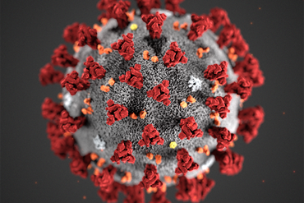
EFFECT OF COVID-19 ON FAMILY PLANNING SERVICES
Source: CDC

Slide 9
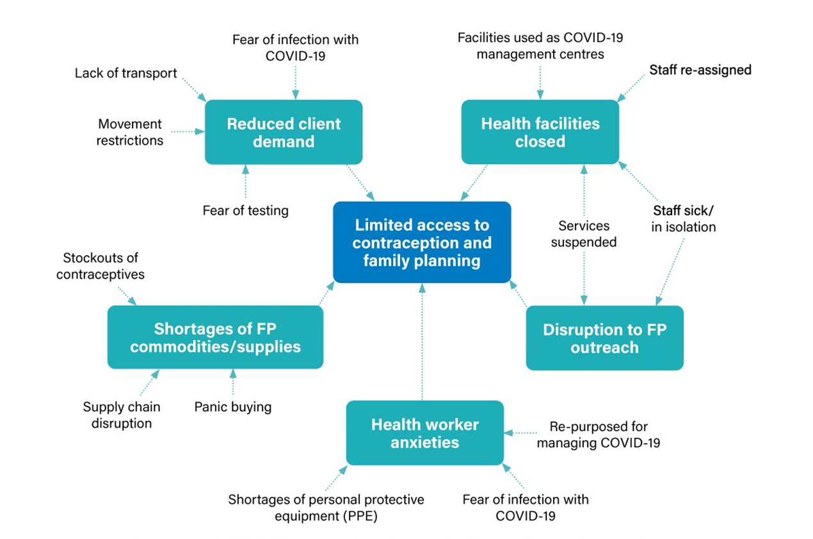

Effect of COVID-19 on family planning services
Source: Rita Kabra, Komal P. Allagh, WHO FP Accelerator project

Slide 10
Effects of COVID-19 on family planning
The full impact on family planning and women and girls' access to services still is not known, and will not be for some time
Early assessment shows -
  Two-thirds of the 103 countries surveyed by the World Health Organization reported disruptions to family planning and contraceptive services (Pulse survey on continuity of essential health services during COVID-19 pandemic-Interim report).
  Lockdowns and movement restrictions have impacted access to services and the availability of commodities and supplies. This is particularly true with long-acting reversible contraceptives (LARCs) as they require healthcare workers for insertion and removal procedures, as well as clients were afraid to go to health facilities.
  This has implications for changes in the method mix, discontinuation rates for short-term contraceptive methods (STMs).
Notes:
World Health Organization. Pulse survey on continuity of essential health services during the COVID-19 pandemic. Interim report. 27 August 2020. Retrieved on 31st May 2021 from https://apps.who.int/iris/bitstream/handle/10665/334048/WHO-2019-nCoV-EHS_continuity-survey-2020.1-eng.pdf?sequence=1&isAllowed=y

Slide 11
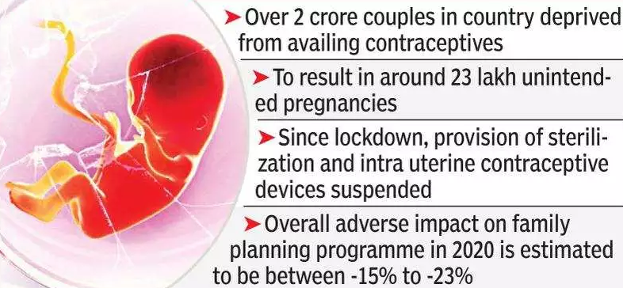
An example of impact of COVID-19 on FP services in India
Source: Times of India, 12th July 2020

Slide 12
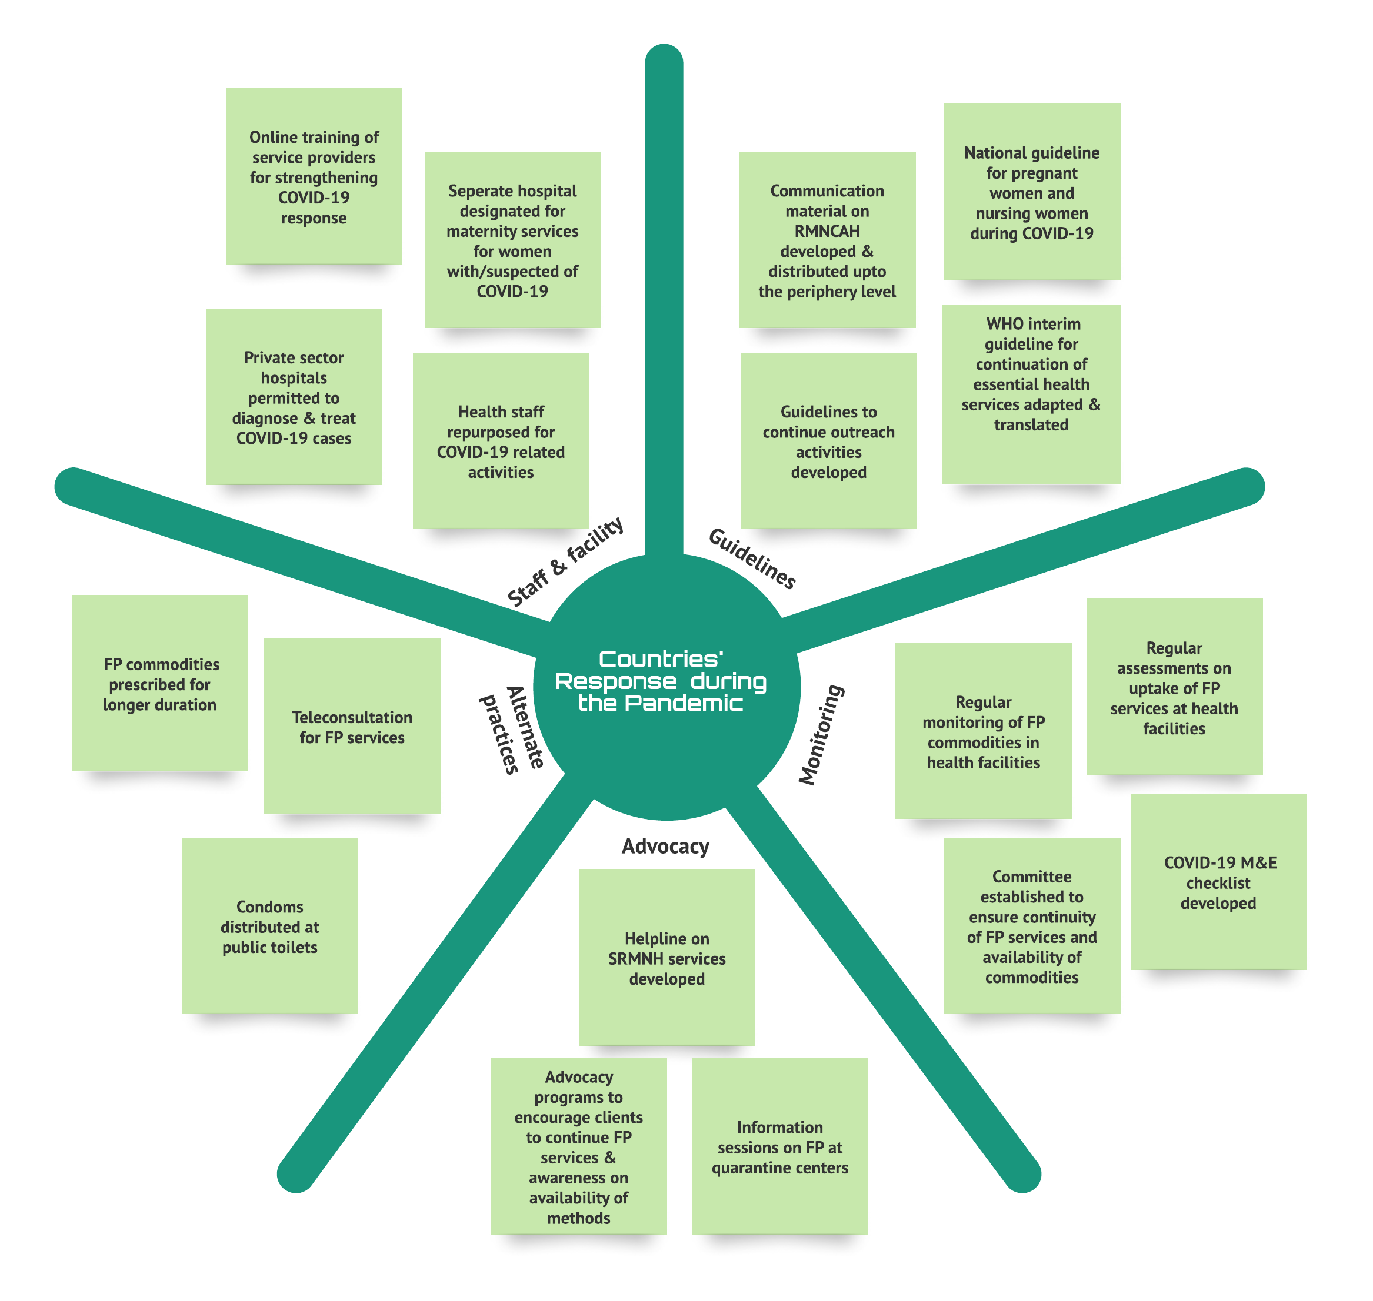
Response to maintain FP services during the pandemic
Source: Rita Kabra, Komal P. Allagh, WHO FP Accelerator project

Slide 13
WHO guidance to maintain FP services during the pandemic

Slide 14
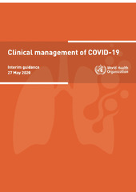
WHO guidance to maintain FP services during the pandemic
OPERATIONAL GUIDELINES
COMMUNITY BASED HEALTH CARE
CLINICAL MANAGEMENT

Slide 15
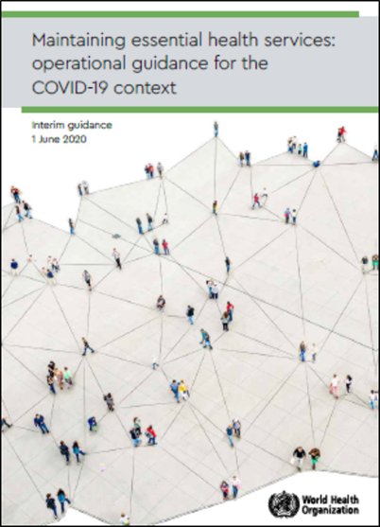
Operational guidelines: Maintaining essential health care services
Establish simplified purpose-designed governance and coordination mechanisms to complement response protocols.
Prioritize essential services, including vaccination, care during pregnancy, childbirth and in the postnatal period, FP, care for young infants and older adults, mental health and psychosocial care.
Optimize service delivery settings and platforms, including in alternative locations and models, community services, targeted outreach, and teleconsultation.
Establish effective patient flow at all levels, including screening, triage, isolation of suspected and confirmed patients, targeted referral.
Rapidly re-distribute health workforce capacity, including by re-assignment and task sharing, remote training.
Maintain population trust to safely meet population needs and control infection risk.
Fund public health and remove financial barriers to access.
Strengthen communication strategies to support the appropriate use of essential services.
Strengthen the monitoring of essential health services.
Use digital platforms to support essential health service delivery.

Slide 16
Operational guidelines: Maintaining essential FP services
Programming evidence-based guidance & tools
  Support continuation of SRH services and triaging.
  IEC materials- Information about delayed availability of LARCs (IUCDs, implants) and sterilization services until resumption of routine services.
  Ensure adequate supply of contraceptive.
  Guidance to expand self-care including self-injection of DMPA.
  Standards for Infection prevention during IUD, PPIUCD and implant insertion (PP 16 ).
  Telemedicine- strengthen outreach services.
Capacity building/ Training of health care providers
  Online training tools for health care providers on FP /PPFP.
  Training FP providers on IPC standards and COVID 19 response.
  Training material & job aids on use of PPE.
Data support & monitoring
  Standardized format for reporting COVID-19 cases among couples using family planning methods.
  Monitoring last mile distribution of contraceptive and FP services.

Slide 17
Clinical management of COVID-19
3 main sections-
Guidance on infection prevention measures
Modifications for safe delivery of services
Transition towards restoration of activities
https://apps.who.int/iris/bitstream/handle/10665/332196/WHO-2019-nCoV-clinical-2020.5-eng.pdf
2022 update: https://www.who.int/publications/i/item/WHO-2019-nCoV-clinical-2022-1

Slide 18
1. Guidance on infection prevention measures: COVID 19
Standards for Infection prevention during IUD, PPIUCD and implant insertion (PP16 ).
Use the mask for provider and client and positioning of patient to keep the coughs away.
Optimize service delivery settings and platforms, including in alternative locations and models, community services, targeted outreach, and teleconsultation.
Establish effective patient flow at all levels, including screening, triage, isolation of suspected and confirmed patients, targeted referral.
Strengthen health workforce capacity, including by re-assignment and task sharing, remote training.
Maintain population trust to safely meet population needs and control infection risk.
Monitor & communicate about where services can be accessed.

Slide 19
2. Modification for safe delivery of FP services
If a woman’s regular contraceptive method is not available, other contraceptive options (including barrier methods, fertility awareness-based methods and emergency contraceptives) should be made more readily available.
Relax requirements for a prescription for oral or self-injectable contraception and emergency contraception and provide multi month supplies with clear information about the method and how to access referral care for adverse reactions.
Enable pharmacies and drugstores to increase the range of contraceptive options they can provide and allow for multimonth prescriptions and self-administration of subcutaneous injectable contraceptives if available.
Notes:
Plan for clients to return to longer-term reversible methods (such as IUDs specifically PPIUD , implants) and permanent methods (tubal ligation and vasectomy) if these services were disrupted

Slide 20
3. Transition towards restoration of activities
Plan for clients to return to longer-term reversible methods (such as IUDs specifically PPIUD, implants) and permanent methods (tubal ligation and vasectomy) if these services were disrupted.
Assess inventory and maintain data related to forecasting procurement and distribution of contraceptives to avoid potential stock outs.
Monitor and communicate about where services can be accessed.
Use digital platforms, telemedicine, tele counselling where possible.

Slide 21
Community-based health care (outreach and campaigns) during COVID-19 pandemic
Support trained community health workers to continue providing counselling at the community level about contraceptive options.
Address users preferences for contraceptive methods that may change in the setting of the COVID-19 pandemic, based on potential disruptions of supply chains and limitations on access to health care facilities.
Ensure that the community health workforce includes health workers who are appropriately trained to safely provide family planning services and information.
Where appropriate, offer digital decision support tools to assist the community health workforce to safely provide contraception.

Slide 22
Contraception/ Family planning and COVID-19: Questions and Answers (WHO-HQ, SRH)
Is contraception/ family planning safe to use?
I want to avoid getting pregnant. What can I do?
I can’t access my contraceptive method of choice. What do you advise?
As a programme manager how can I help people access services?
What is the best contraceptive method to use?
I want to change my contraceptive method – is this possible?
I want to remove or replace my implant or IUD – can I do this?
Why is providing contraception/ family planning, important?
As a policy maker what can I do to ensure contraception/ FP access?

Slide 23
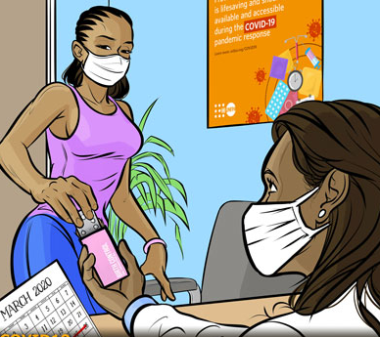
CONCLUSIONS: What do countries need to do to maintain FP services during the pandemic?
FP and reproductive health services should be included in the package of essential services and develop strategies to ensure women and couple exercise their reproductive rights during the COVID-19 crisis
Reorganization of service delivery –physical distancing
Alternate models for service delivery – Tele Health and Private sector engagement
HR re-deployment, task shifting and capacity building
Ensure availability of drugs, Supplies & Equipment
Additional financial resources for the facilities
Source: UNFPA

Slide 24
Additional reading
WHO guidance on protecting human rights under the COVID-19 response.
Critical guidelines on the safe provision of sexual and reproductive health services in the COVID-19 context.
The Inter-Agency Working Group on Reproductive Health in Crises (IAWG) developed a programmatic guidance specifically adapted to the COVID-19 crisis.
International Federation of Gynecology and Obstetrics (FIGO) created a COVID-19 resource page on women’s health.

Slide 25
WHO guidance to maintain FP services during the pandemic
https://apps.who.int/iris/bitstream/handle/10665/332240/WHO-2019-nCoV-essential_health_services-2020.2-eng.pdf
https://apps.who.int/iris/bitstream/handle/10665/332196/WHO-2019-nCoV-clinical-2020.5-eng.pdf
https://apps.who.int/iris/bitstream/handle/10665/331975/WHO-2019-nCoV-Comm_health_care-2020.1-eng.pdf
2022 update: https://www.who.int/publications/i/item/WHO-2019-nCoV-clinical-2022-1

Slide 26
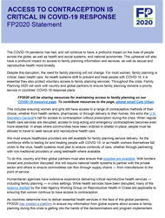
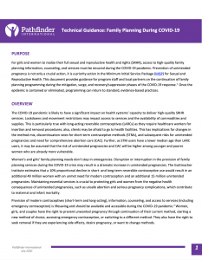
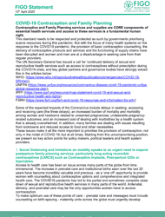
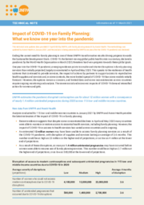
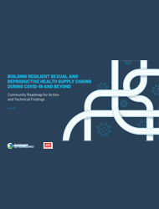
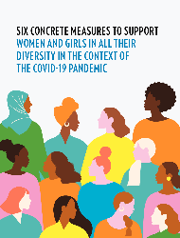
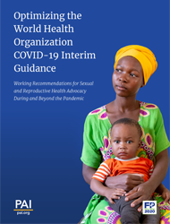
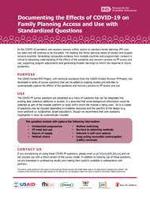
https://fp2030.org/covid-19

