Slide 1
Recent evolutions and research agenda in the field of SRHR
September 2022
GFMER
Dr Moazzam Ali MD, PhD, MPH
Department of Reproductive Health and Research

Slide 2
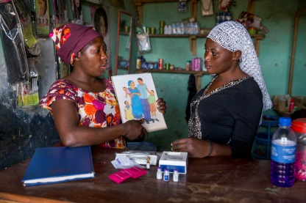
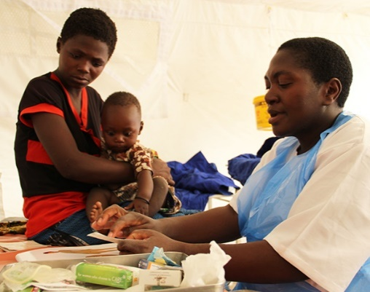
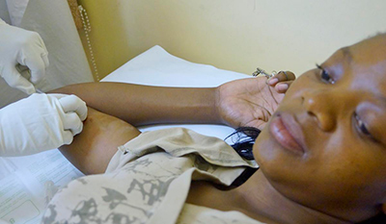
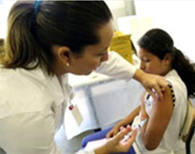
Magnitude of the problems related to sexual and reproductive health and rights
As of recent, an estimated
295 000 women died from pregnancy-related causes
2.7 million babies died during the first 28 days of life and
2.6 million babies were stillborn. 98% of stillbirths take place in low-income and middle-income countries.
Child marriages: 39 000 every day.
About 1 million girls under 15 give birth every year—most in low- and middle-income countries.
An estimated 214 million women have unmet need in contraception in developing countries .
Recent estimates: 56 million induced abortions occurred each year worldwide.
Each year, there are an estimated 357 million new infections with 1 of 4 STIs: chlamydia, gonorrhea, syphilis and trichomoniasis.
1 in 3 women worldwide have experienced either physical and/or sexual intimate partner violence.

Slide 3
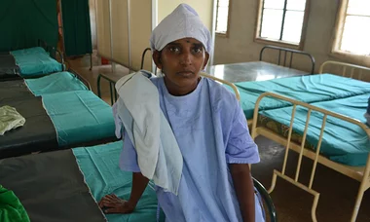
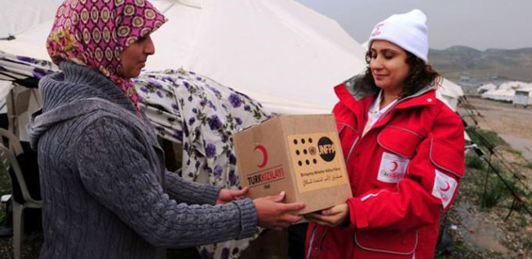
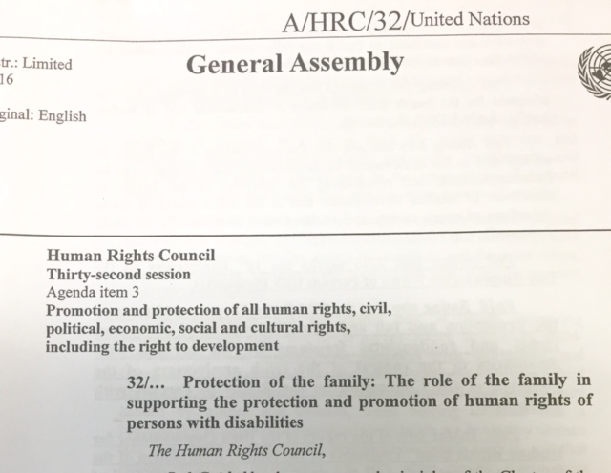
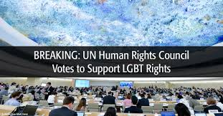
Several challenges to ensuring and protecting SRH rights remain
Addressing sexuality, sexual health, safe abortion, and gender relations continue to be challenging politically
Integrating SRHR in humanitarian responses essential but modalities unclear

Slide 4
WHO/HRP’s core functions
The right to attain the highest standard of sexual and reproductive health
Research
Capacity Strengthening
Global Leadership
Normative guidelines
Innovations
Indicator monitoring
Determinants & consequences
Institutional, organizations, individuals
Methodology development
SRHR advocacy
Convening credibility
Networking

Slide 5
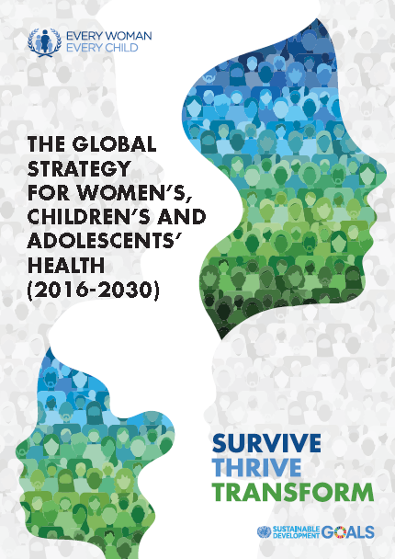
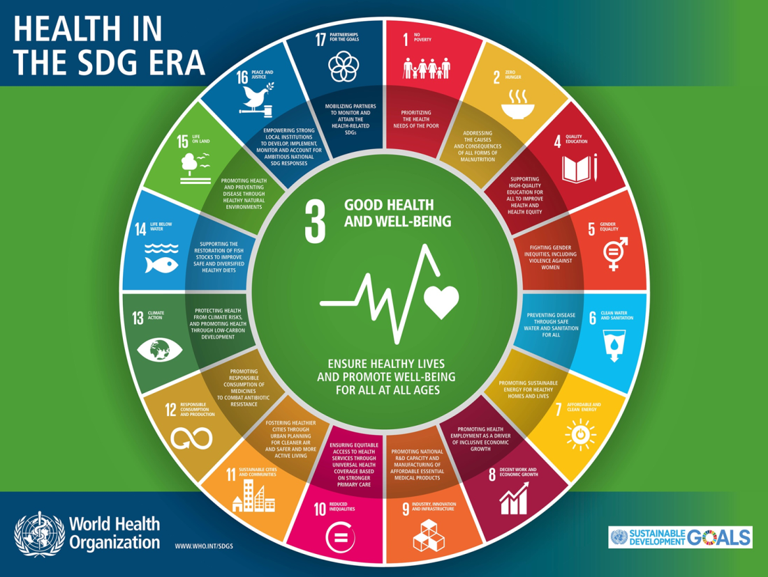
Aligning with the SDGs and Global Strategy for Women’s, Children’s and Adolescents’ Health

Slide 6
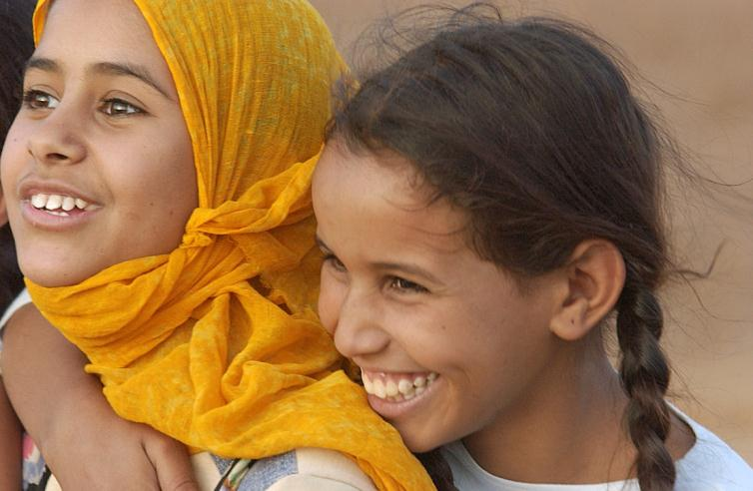
What is new?
Equity Focus on reaching the most vulnerable and leaving no one behind
Universality For all countries, with an explicit focus on humanitarian settings
Adolescents The “SDG generation” – a 10 year old in 2016 will be 24 in 2030
Life-course approach Health and well-being interconnected at every age, and across generations
Multisector approach Joint progress across core sectors e.g. nutrition, education, WASH
Notes:
This Global Strategy is much broader, more ambitious, and more focused on equity than its predecessor.
It is universal and applies to all people (including the marginalized and hard-to-reach), in all places (including crisis situations), and to transnational issues. It explicitly focuses on safeguarding women, children and adolescents in humanitarian settings and upholding their human right to the highest attainable standard of health, even in the most difficult of circumstances.
Adolescents join women and children at the heart of the strategy
A “life course” approach that aims for the highest attainable standard of physical, mental and social health and well-being at every age. A person’s health at each stage of life affects their health at other stages and also has knock-on effects for the next generation.
Finally, the Global Strategy adopts an integrated and multisector approach, recognizing that non-health sectors—including nutrition, education, water, sanitation, hygiene, and infrastructure—are essential to improving health and well-being, reducing inequities, tackling new environmental challenges, achieving the SDGs and implementing the Global Strategy.

Slide 7
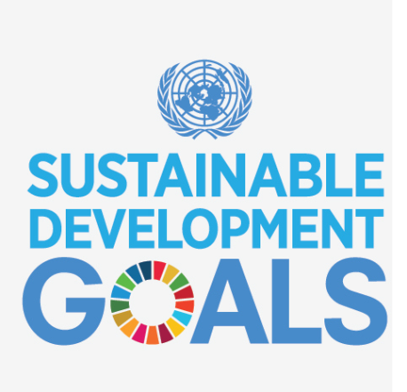
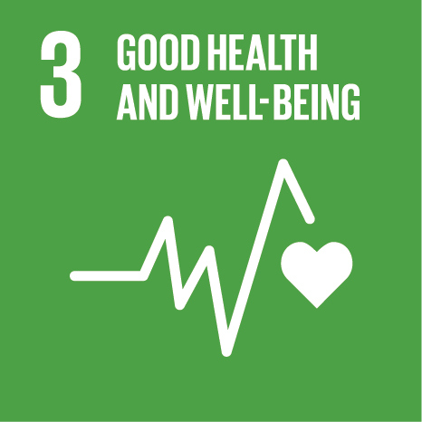
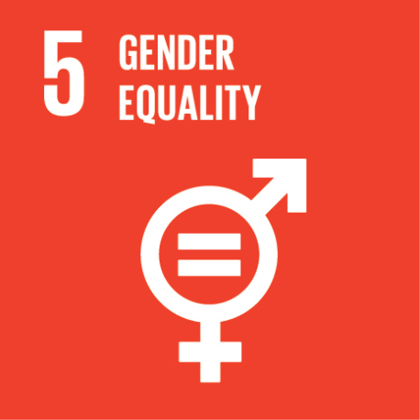
Contributing to SDG indicators related to SRHR
SDG 3.1.1 | Guidance on increasing access to contraception and improving maternal health services to reduce maternal deaths and improve well-being
SDG 3.1.2 | Guidance on strategies to increase access to SBA and quality of SBA services
SDG 3.2 | Research to improve quality of perinatal care and development of normative guidance
SDG 3.3 | Implementation research to support implementation of the global STI strategy and to strengthen SRHR-HIV linkages
SDG 3.7.1 | Implementation research to support scaling up of effective interventions to satisfy demand for contraception
SDG 3.7.2 | Implementation research to support reduction of unintended pregnancy among adolescents
SDG 5.2 | Implementation research to support the global plan of action to strengthen health systems response to violence against women, girls and children
SDG 5.3.1 | Research and technical support to parliamentarians to determine how to legislate effectively against CEFM
SDG 5.3.2 | Research to improve medical care and management of girls & women with FGM in accordance with WHO guidance
SDG 5.6 | Technical support to enable states to safeguard rights to universal access to SRH services
Notes:
To present SDGs indicators related to SRHR.
To present the responsible unit within WHO for reporting on the following indicators: MMR, preterm births, violence against women, STIs.

Slide 8
Strategic directions for WHO/HRP: Transitions to align with trends
Global National
Application of norms & standards, best practices
Implementation research for institutionalization
Capacity-building for production and use of evidence
Medical Systems
Building blocks, especially financing (UHC)
Integration, wherever appropriate
Total Market Approaches
Protection Well-being
Mortality, morbidities and rights
Personal / couple desires
Level
Intervention
Outcomes

Slide 9
Framework of Evolution of SRHR Research: Discovery to Delivery
Effective innovations
Effective
Implementation
Enabling
Contexts
Socially
Significant
Outcomes
Implementation research
Epidemiological and behavioural research
Scalable
Sustain
able
Basic science research

Slide 10
Key areas of research
Innovation in technology (POCT, maternal health management, HPV vaccines)
Integration of services (HIV and syphilis, HIV and contraception, immunization)
Research to support development and implementation of guidelines at country level
Innovative financing (vouchers, conditional cash transfer)
Capacity building (multipurpose workers, staff retention)
Social determinants in health
Equity aspect (adolescent health issues)
Monitoring and accountability (MMR, STI estimates)
Emerging issues (Zika, Ebola, covid)

Slide 11
Overall alignment good; some reorientation needed
UHC as a platform for an integrated approach for delivering SRH services; health security and greater consideration of socio- economic interactions needed
Intersectoral action: stronger integration with the economic, social and environmental determinants needed
Equity: absolutely critical, and for all countries; need for focus on sub-national data and actions
Gender Equality and Human Rights: need for stronger and deeper integration of gender equality and human rights
Financing shifts to greater domestic financing; least developed and fragile countries continue to need ODA assistance
Monitoring and accountability framework requirements enormous; increased role for HRP

