Slide 1
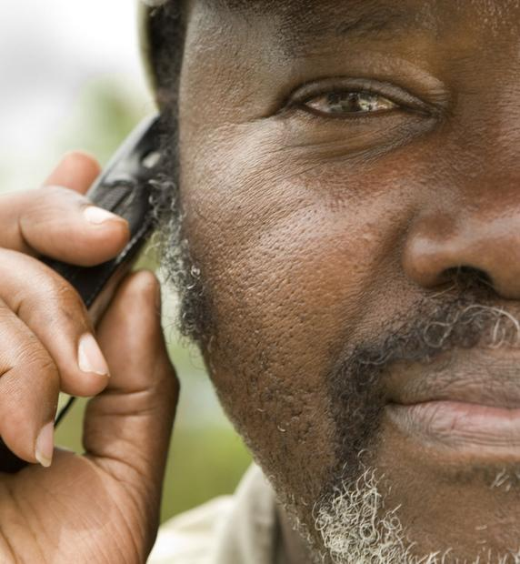
Introduction to mHealth
mHealth for Sexual Reproductive and Maternal Health
Madhu Deshmukh
Director - MNCH, mHealth, and Gender
mHealth Alliance
mdeshmukh@mhealthalliance.org
February 15, 2013

Slide 2
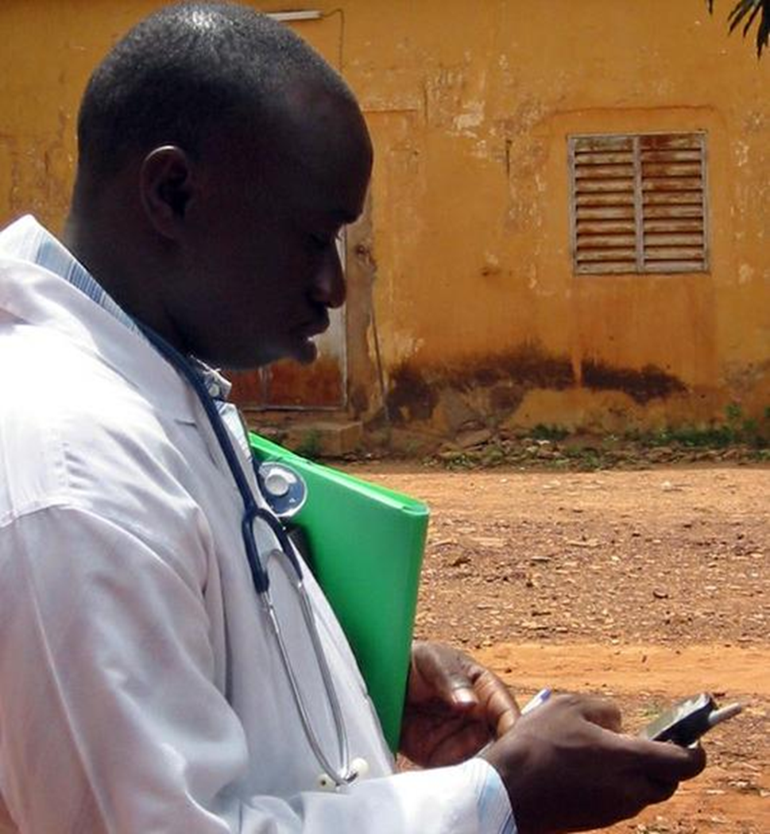
Definition of mobile health or mHealth
Medical and public health practice supported by mobile devices, such as mobile phones, patient monitoring devices, tablets, personal digital assistants (PDAs), and other wireless devices.
Mhealth Alliance | 2
Mhealth Alliance | 3
Notes:
Since mobile technology has succeeded in reaching remote, poor regions when other modern ICTs have not, it can be a significant ICT tool for addressing major problems plaguing health systems and improving health care in LICs: reach, accessibility, quality, effectiveness

Slide 3




The Crisis
7 Billion
People
6 Billion
Mobile Phone Users
1 Billion
Mobile Phone Users
Have No Healthcare
Mhealth Alliance | 3
Notes:
Lack of basic health care in developing world – avg. ratio between doctors and patients is 1 : 250,000
Top causes of death in LICs (i.e. respiratory infection, diarrheal disease, TB, HIV/AIDS, low birthweight, neonatal infections) – many of these are preventable and treatable through basic information, education, and access to simple lifesaving interventions

Slide 4
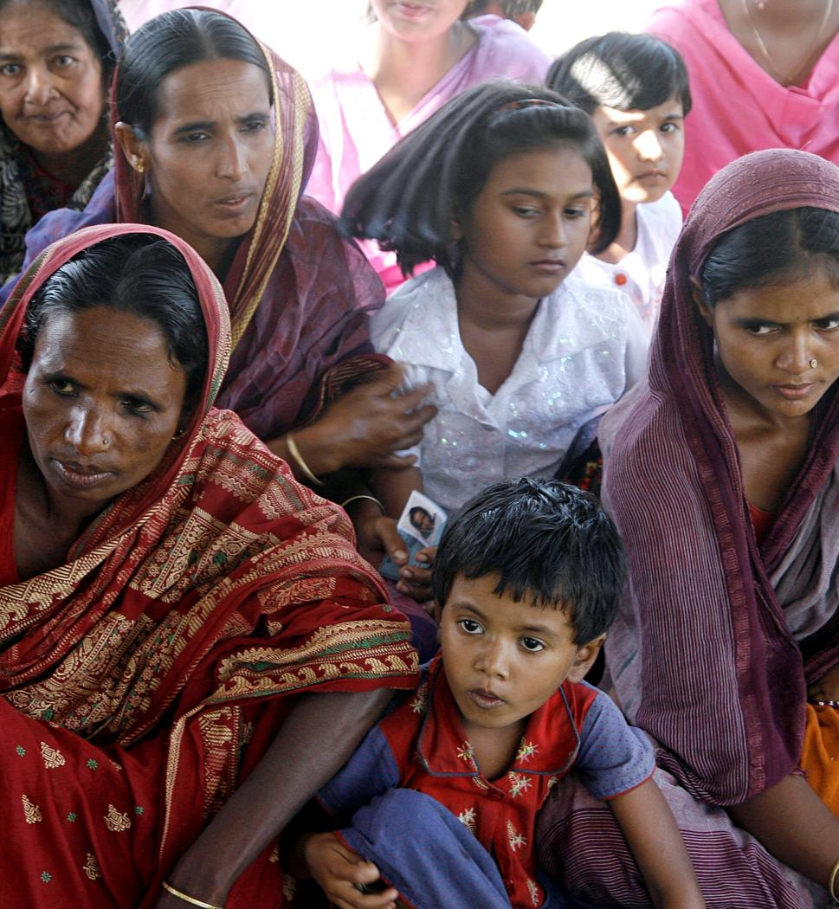
Lack of Basic
Health Care
1: 250,000
The average ratio between doctors and patients in developing countries.
Mhealth Alliance | 4

Slide 5
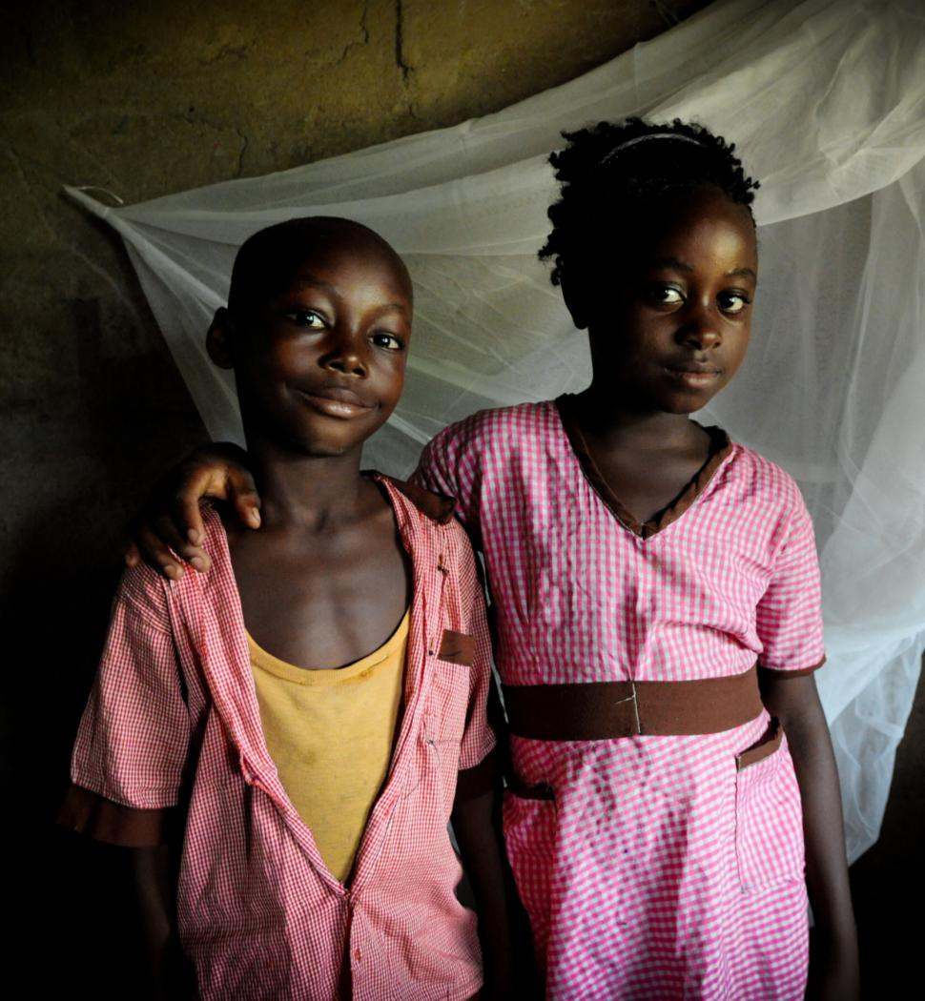
Top 10 Causes
of Death in Low-Income Countries
Lower respiratory infection
Diarrheal diseases
HIV/AIDS
Ischemic heart disease
Malaria
Stroke and other heart disease
Tuberculosis
Prematurity and low birth weight
Birth asphyxia and birth trauma
Neonatal infections
Mhealth Alliance | 5
Notes:
Source: WHO http://www.who.int/mediacentre/factsheets/fs310/en/index4.html
Many of these causes of death are preventable through basic information, education and access to simple interventions.

Slide 6
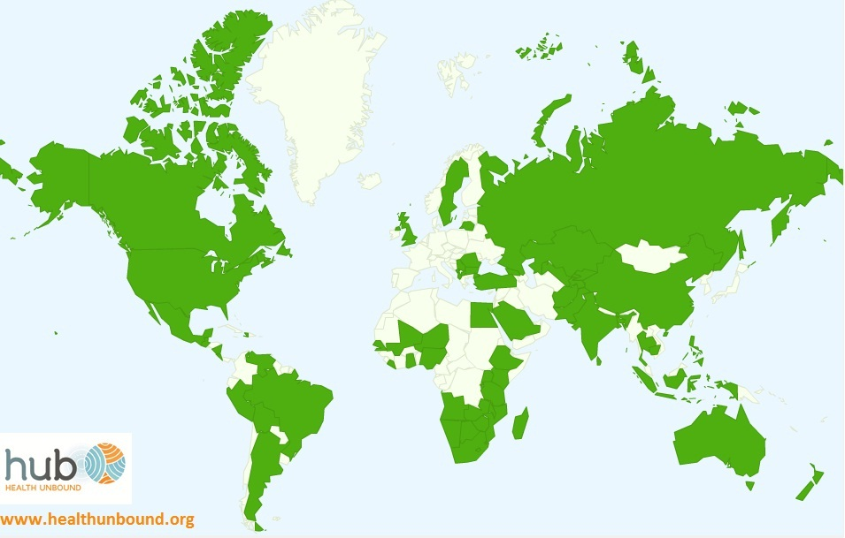
mHealth Around the World
83% of WHO member countries reported having at least one mHealth initiative in their country.¹
77% of responding low-income countries reported at least one mHealth initiative in their country, making them only ten percent behind high-income countries.¹
¹World Health Organization. mHealth: New horizons for health through mobile technologies: second global survey on eHealth. http://www.who.int/goe/publications/goe_mhealth_web.pdf.
Mhealth Alliance | 6
Notes:
mHealth survey conducted by WHO’s Global Observatory for eHealth in 2009
In both developed/developing world – many countries are building & implementing national mHealth strategies

Slide 7
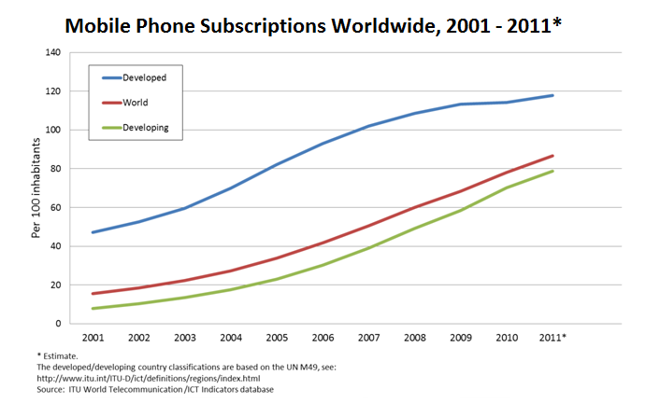
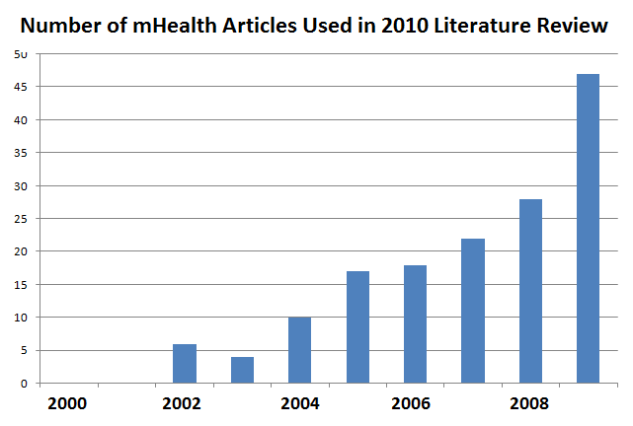
Progression of mHealth
With the rise in
mobile subscriptions worldwide…
… comes a rise in mHealth initiatives in countries around the world.
Mhealth Alliance | 7
Notes:
Source: Save the Children’s 2012 State of the World’s Mothers Report
In LMICs- network of mobile subscribers far greater than the number of fixed-line connections

Slide 8
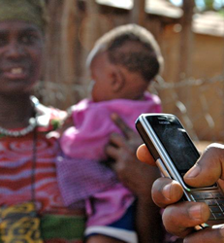
Mobile Technology Changes the Face of Access to Information
77%
of mobile subscriptions are in developing countries
75%
of the world now have easier access to a mobile phone than a bank account, electricity, or clean water
Mhealth Alliance | 8
Notes:
Statistics: World Bank, 2012
“In less than three decades, the mobile phone has gone from being a status symbol to being a ubiquitous technology that facilitates almost every interaction in our daily lives.”
TechCrunch, 2012

Slide 9
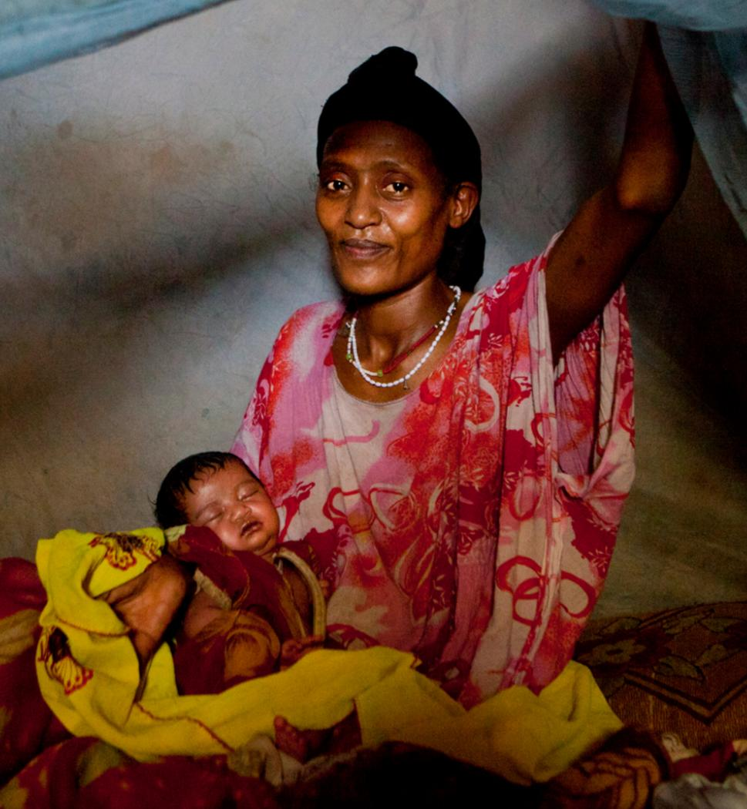
Informed = Preventable
For hundred of millions of people in developing countries, lack of basic health services is an issue of access to basic information and intervention.
Mhealth Alliance | 9

Slide 10
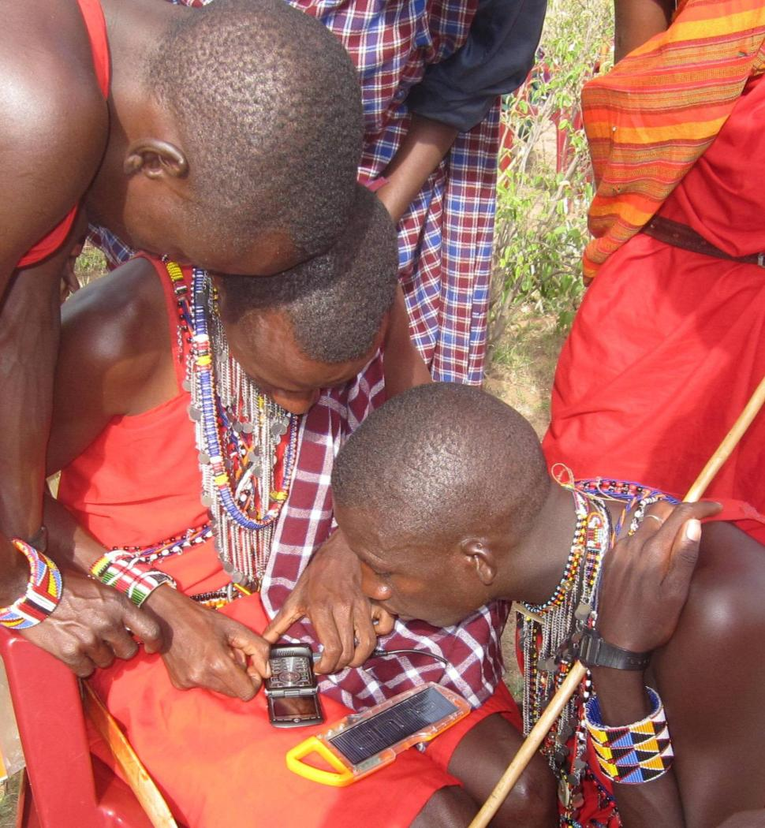
For hundreds of millions of people in developing countries, lack of basic health services is an issue of access to basic information and intervention.
Mobile Devices
+ Health Information
can Effectively and Efficiently help people across the globe.
Mhealth Alliance | 10
Notes:
Phones can: provide pregnant women with tips on exclusive breastfeeding for building immunity in children; send lab results for an HIV test instantaneously to a health worker and improve the timeliness of treatment for infected patients

Slide 11






How?
mHealth is a Cross-Cutting Tool Providing:
Education
& Awareness
Healthcare Worker
Communication & Training
Diagnostic
Treatment & Support
Remote
Monitoring
Disease & Epidemic
Outbreak Tracking
Remote Data
Collection
Mhealth Alliance | 11
Notes:
Phones can cut across the barriers that traditionally prevent many from accessing the health system: geographic, cost, time, low technology, human resources, financial

Slide 12
The Potential Impact of mHealth
[
]
Improving quality of care provided by millions of health workers
Providing direct health information and support
to citizens
+
=
A holistic and personalized approach to healthcare
Mhealth Alliance | 12
Notes:
Phones can provide clients who otherwise can’t access the health system with crucial health information on disease, childcare, pregnancy, etc.; also offer direct services to clients (appointment reminders, treatment adherence reminders, etc.)
Phones can strengthen HW capacity through providing training, connecting them with a greater network of resources/other HWs, and giving HWs the tools to properly diagnose, treat, and monitor patients

Slide 13
mHealth Focus Areas
Cause of Death
mHealth Intervention
Prematurity, low birth weight and neonatal infections
Maternal and prenatal
care
HIV/AIDS
Awareness and testing
Heart disease
Smoking cessation
Tuberculosis
Vaccination
Mhealth Alliance | 13
Notes:
These are the 4 “Health Focus Areas” for mHealth Alliance – all on the top 10 causes of death list. If that have an mHealth intervention for all Top 10, GREAT!

Slide 14
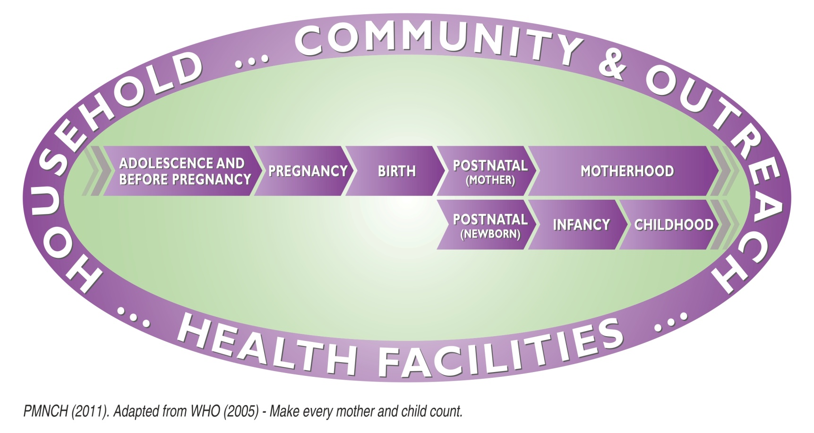
The Continuum of CARE for SRMH
Mhealth Alliance | 14

Slide 15
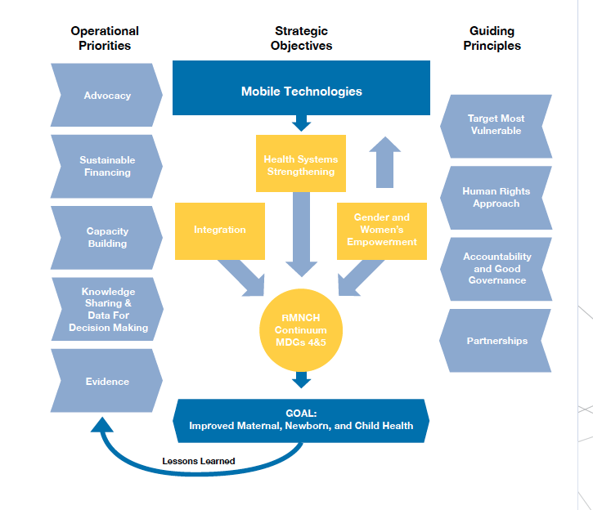
M
MNCH mHealth Framework
Mhealth Alliance | 15

Slide 16
mHealth Focus Areas
Cause of Death
mHealth Intervention
Prematurity, low birth weight and neonatal infections
Maternal and prenatal
care
HIV/AIDS
Awareness and testing
Heart disease
Smoking cessation
Tuberculosis
Vaccination
Mhealth Alliance | 16
Notes:
These are the 4 “Health Focus Areas” for mHealth Alliance – all on the top 10 causes of death list. If that have an mHealth intervention for all Top 10, GREAT!

Slide 17
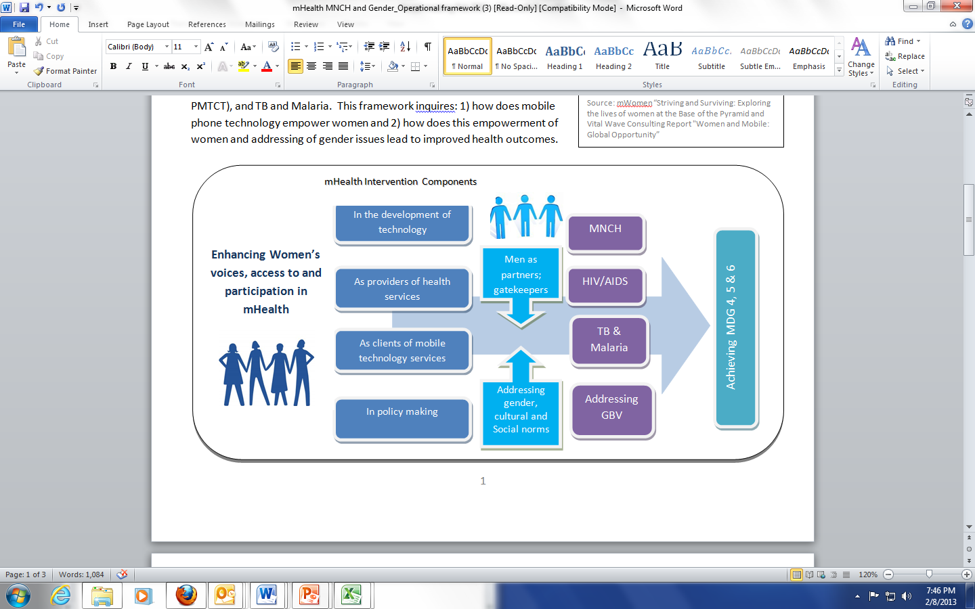
Gender Mainstreaming Framework
Mhealth Alliance | 17

Slide 18
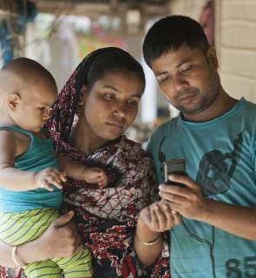
The mHealth Opportunity
Ministers of Health are making the mHealth connection.
Huge penetration
of mobile phones.
Rising endemic
health issues.
Mhealth Alliance | 18
Notes:
Example: as part of the ‘Saving One Million Lives’ Initiative in Nigeria, the FMoH has prioritized the use of ICT (mHealth/eHealth) to scale up access to PHC for women/children and save 1 mn lives by 2015
FMoH currently working with mHealth Alliance and partners to come up with a systematic plan for leveraging mobile technology to achieve better health outcomes for its population

Slide 19
Ruma’s Story: “m” is for Mothers
Mhealth Alliance | 19

Slide 20

Ruma’s Story
17-year-old Ruma is pregnant and living in Bangladesh, ranked 11th in child-death.
She is diabetic with no access to basic maternal or prenatal care.
Mhealth Alliance | 20

Slide 21


Ruma’s Story
Her home is 100 miles from the closest medical clinic.
Mhealth Alliance | 21

Slide 22

Ruma’s Story
What Ruma does have is a mobile phone.
Through voice and text messages on her prepaid mobile phone Ruma gets news on her baby’s development and nutrition recommendations to support prenatal health.
Mhealth Alliance | 22
Notes:
1) More than 3 million newborns die each year due to preventable illnesses and complications and Ruma and her unborn child are at highest risk.
2) More than 20,000 children die every day in developing countries due to limited access to frontline health workers.
Source: Save the Children, State of the World’s Mothers Report. 11th for child death in children under 5

Slide 23

Ruma’s Story
An app helps her manage and track her insulin and blood sugar and
she can text questions to her health care worker who can help her in real-time.
Mhealth Alliance | 23
Notes:
1) More than 3 million newborns die each year due to preventable illnesses and complications and Ruma and her unborn child are at highest risk.
2) More than 20,000 children die every day in developing countries due to limited access to frontline health workers.
Source: Save the Children, State of the World’s Mothers Report. 11th for child death in children under 5

Slide 24

Ruma’s Story
After her baby is born, Ruma gets pre-recorded voice messages reminding her of her son’s immunization schedule.
She’s informed in her decision to breastfeed and now
her baby is 6 times more likely to survive his precarious early months.
Mhealth Alliance | 24
Notes:
mHealth Alliance is secretariat of MAMA – Mobile Alliance for Maternal Action. MAMA sends out messages to mothers (and helps them access phones) like the one hyperlinked above They do so in Bangladesh where 62% of the population has a cell phone.
In developing countries, breastfed children are at least 6 times more likely to survive in the early months of life than non-breastfed children. Source: Save the Children’s2012 State of the World’s Mothers Report

Slide 25


Ruma’s Story
Her frontline health worker, hospital, and medical clinic are linked through Ruma’s Health ID.
Her son’s birth does not go unnoticed—the baby now has a Vital Registry ID and counts in the system.
Mhealth Alliance | 25
Notes:
mHealth Alliance is secretariat of MAMA – Mobile Alliance for Maternal Action. MAMA sends out messages to mothers (and helps them access phones) like the one hyperlinked above They do so in Bangladesh where 62% of the population has a cell phone.
In developing countries, breastfed children are at least 6 times more likely to survive in the early months of life than non-breastfed children. Source: Save the Children’s2012 State of the World’s Mothers Report

Slide 26


Ruma’s Story
Ruma is no longer lost in a fragmented health system.
She feels connected and that her family is cared for.
Mhealth Alliance | 26
Notes:
mHealth Alliance is secretariat of MAMA – Mobile Alliance for Maternal Action. MAMA sends out messages to mothers (and helps them access phones) like the one hyperlinked above They do so in Bangladesh where 62% of the population has a cell phone.
In developing countries, breastfed children are at least 6 times more likely to survive in the early months of life than non-breastfed children. Source: Save the Children’s2012 State of the World’s Mothers Report

Slide 27
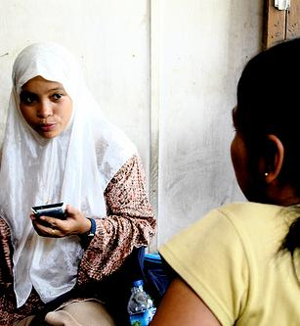
The mHealth Challenge
But coordination in the crowded mHealth space is fragmented, unsynchronized,
and duplicative.
In Kenya alone, there are more than 30 different mHealth initiatives active simultaneously.
Mhealth Alliance | 27
Notes:
Many mHealth projects taking place are small, pilot projects operating in isolation from a broader mHealth ecosystem Lack of evidence and sharing of knowledge within mHealth limits the ability to scale up projecdts and integrate them into the larger health system

Slide 28
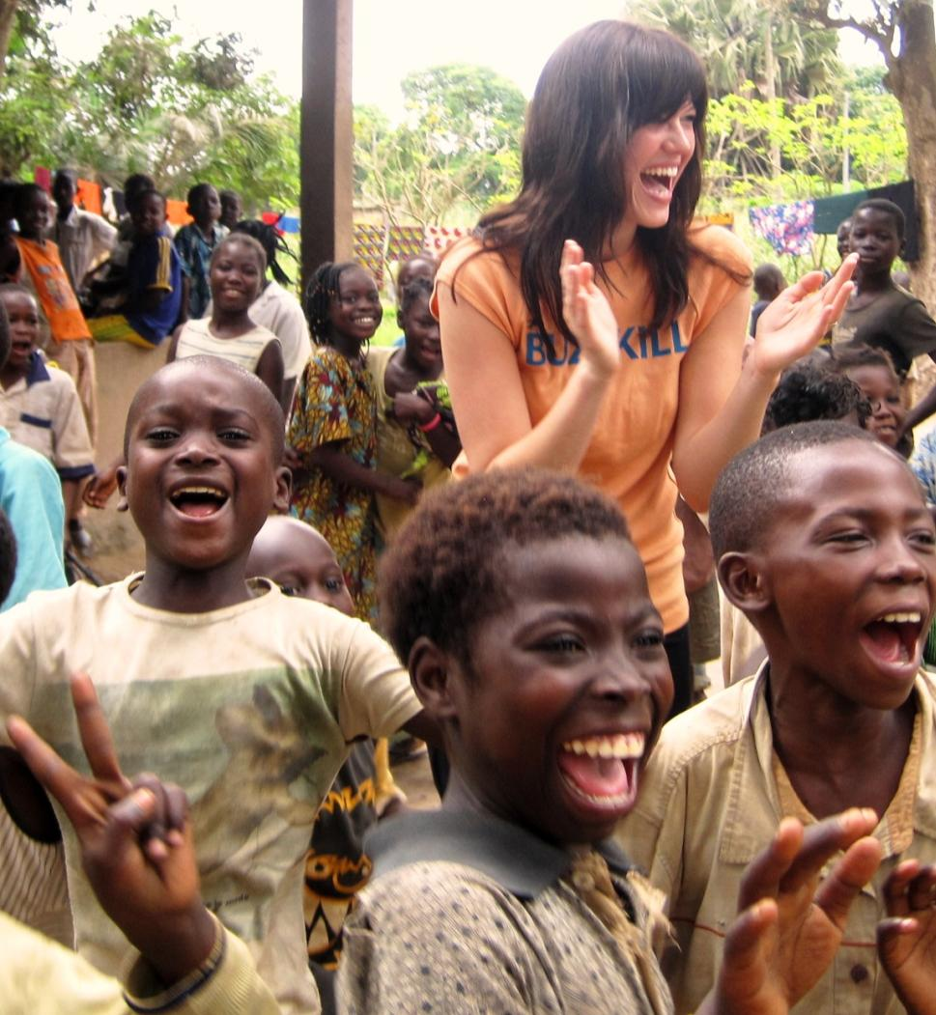
Thank You.

